Slide 1
How Starspot Surface Coverage Affects Stellar Brightness Variability
Miles L. Johnson

Slide 2
Starspots
Sunspots/starspots are dark blotches that appear on the surface of stars.
The underlying processes that govern their formation and death, as well as their affects on the host star, are poorly understood.
Starspots are proposed to explain the discontinuity between theoretical model and observed properties of stars (i.e. low-mass stars always appear 5% larger than theory predicts).

Slide 3
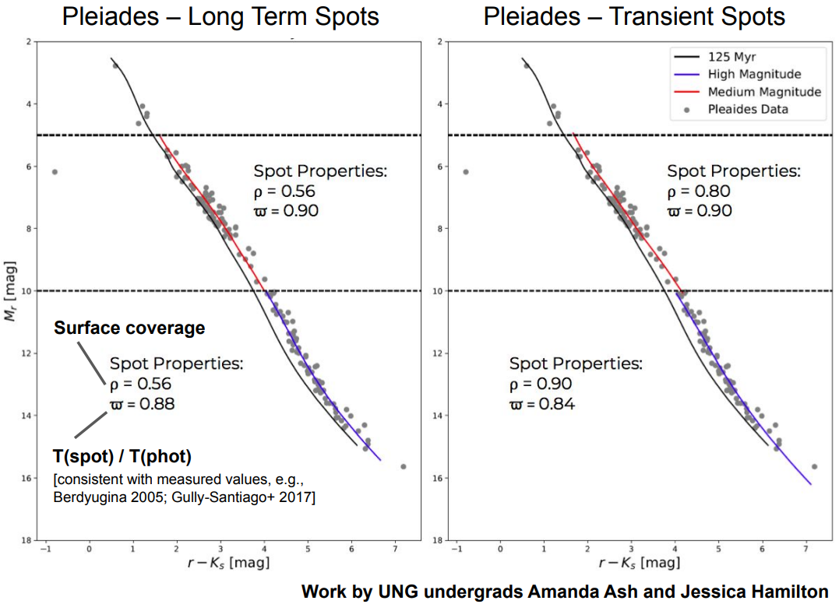
Past Work
Ash and Feiden (in prep) derived starspot properties assuming two different formation scenarios:
Transient spots require that a star have more 75% of its surface covered by spots (ϱ = 0.90, ϖ = 0.84 ).
Long-Term spots that caused deep structural changes require that around half of the star to be covered in spots (ϱ = .56, ϖ = 0.88).

Slide 4
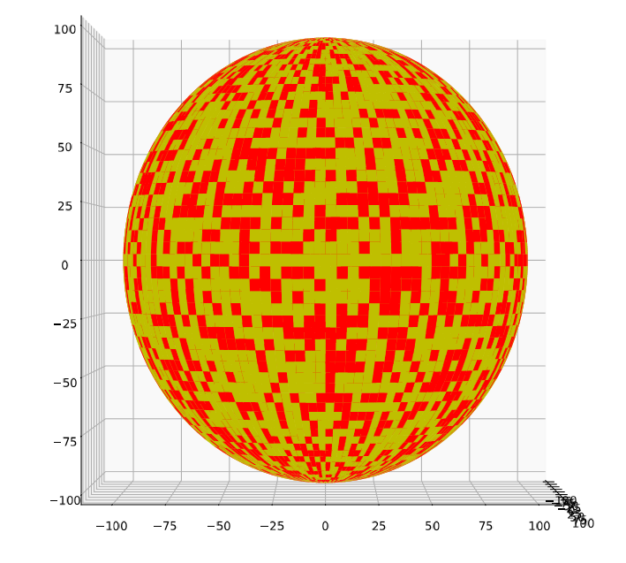
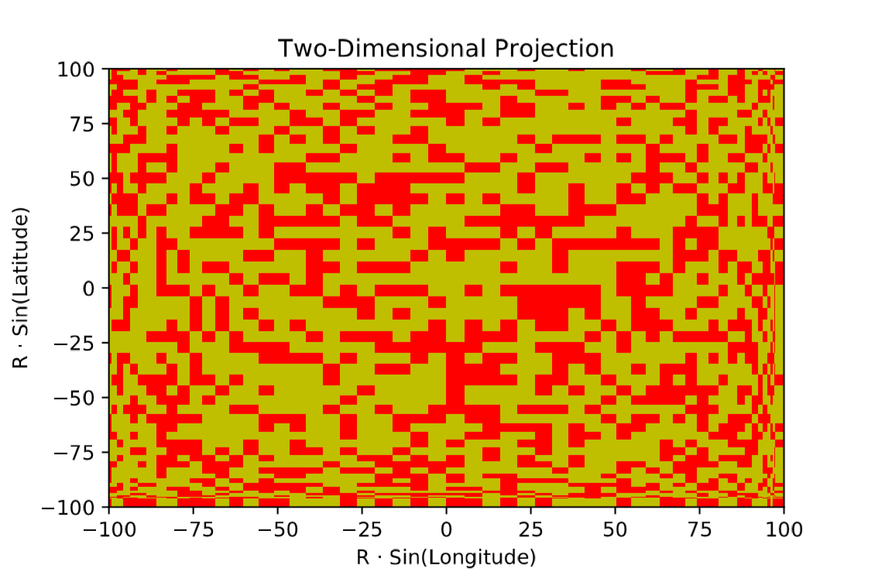
Methodology
A 3D model sphere was created, and this sphere was divided along latitudinal and longitudinal lines to create a surface tessellated with small cells.
Certain cells were randomly selected to be ‘spot cells’ at any desired surface coverage (ϱ).
A surface projection was chosen that conserved apparent surface area.
The 2D projection was written to only display the cells in the visible hemisphere of the 3D model.

Slide 5
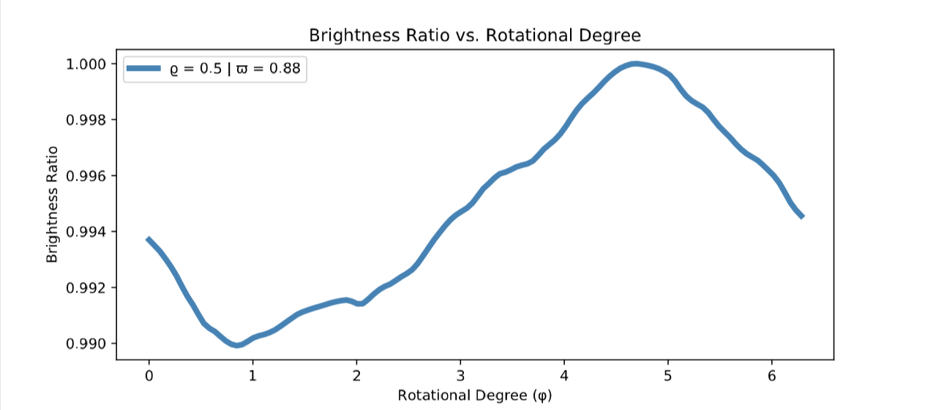
Light Curve Generation and Amplitude Variation
Spot cells were given a lower brightness value based on an assumed temperature ratio between the spots and the background photosphere (ϖ).
The model was then rotated, and a 2D projection was created for each discrete rotation. The brightness from each projection was recorded.
This data was plotted against rotational degree (φ) to create a light curve, and the brightness variation was recorded.

Slide 6
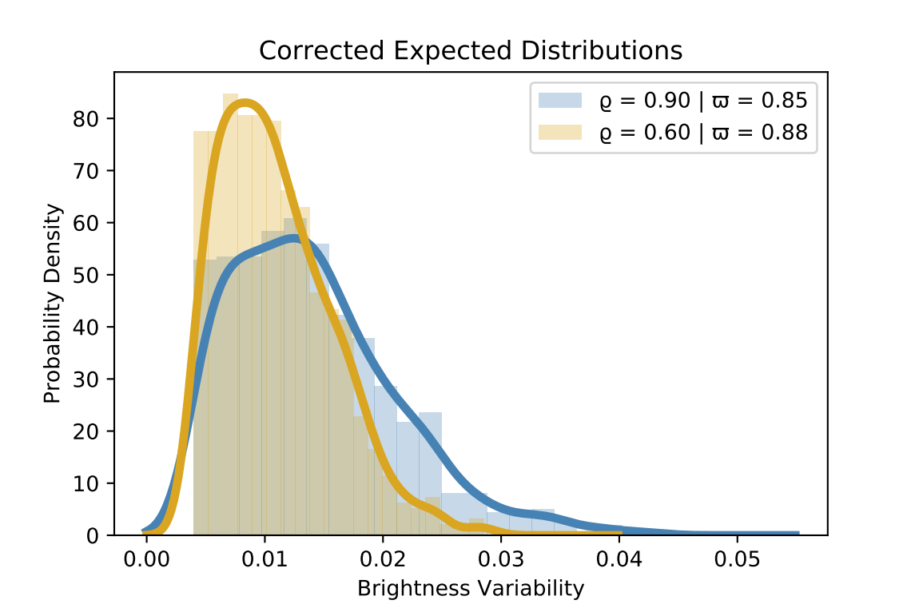
Results
Due to the random nature of each light curve, it was necessary to run the simulation multiple times in order to perform a statistical analysis of the results.
These simulations were performed 1,000 times each for two different test cases.
These test cases (ϱ = 0.90, ϖ = 0.85 and ϱ = 0.60, ϖ = 0.88) were chosen to test Ash’s conditions for transient spots and long-term spots.
Corrections were applied to simulate the random orientation of stars.
Minute variations that could not be observed were omitted in the corrected distributions.

Slide 7
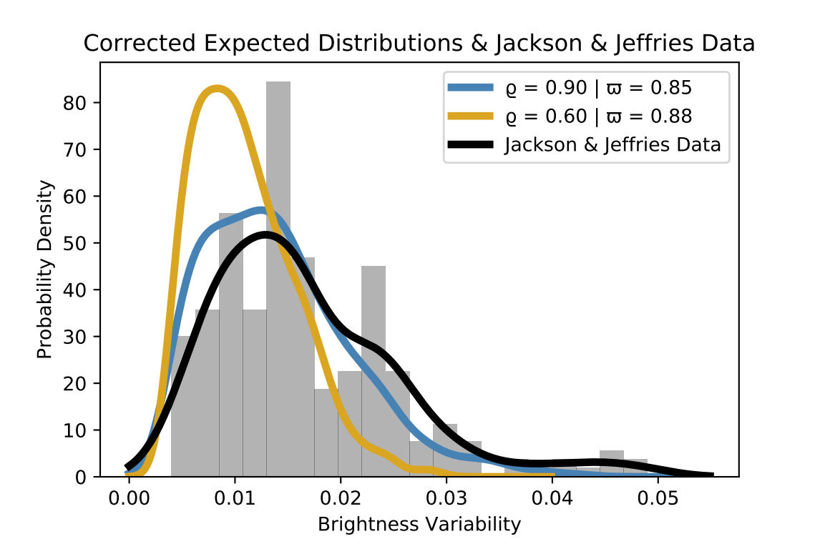
Conclusions
This statistical analysis shows that stars with higher surface coverage tend to show more brightness variability than those with lower surface coverage.
Our findings, when compared to data collected by Jackson & Jeffries in the young open cluster NGC 2516, indicate that the transient (short-term) spot model more closely matches observed phenomena than the long-term spot model.
This implies that spots are transient features, and they cause little if any changes to stellar structure.

